Slide 1



Predictive Analysis of Graduate Admissions
Supervised by :
Dr. Sara Elmetwally
Eng. leqaa hani

Slide 2





01.
Building models that predict admission chances with precision.
Problem Statement :
02.
Identifying key factors contributing to successful applications.
Graduate school admissions rely on multiple parameters, making the process complex and often opaque. Evaluating large-scale applications manually can result in subjective biases and inconsistencies. The challenge lies in accurately determining the weight of each criterion and forecasting admission outcomes. This project aims to address these challenges by:
03.
Providing a tool that aids applicants in optimizing their profiles.

Slide 3



Related Work
https://digitalcommons.fiu.edu/etd/797/
https://link.springer.com/chapter/10.1007/978-3-030-80475-6_17
https://ieeexplore.ieee.org/abstract/document/9397988
01
02
03
Several studies have examined the correlation between standardized test scores and graduate admissions. Research demonstrates that GRE scores and CGPA are strong predictors of academic success.
This paper provides a comparative analysis of different machine learning models used to predict graduate school admissions, evaluating techniques such as Random Forest, Logistic Regression, and K-Nearest Neighbors (KNN).
This study investigates the use of Neural Networks (NN) to predict admissions to graduate programs by analysing applicant data including academic performance and recommendation letters.

Slide 4






Results

Slide 5

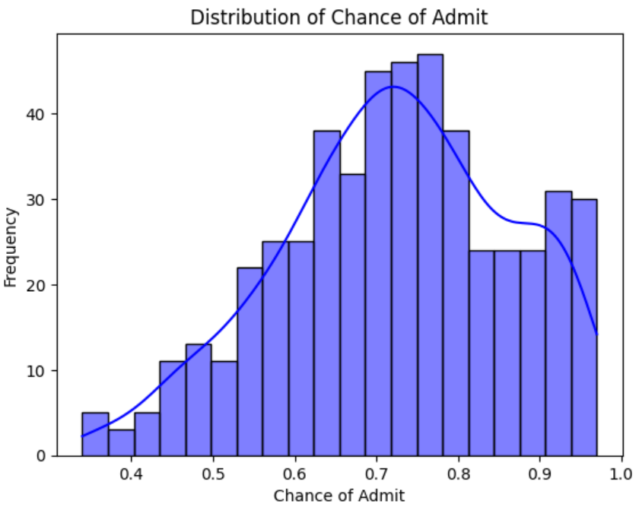
Chance of admit distribution is almost normally distributed

Slide 6
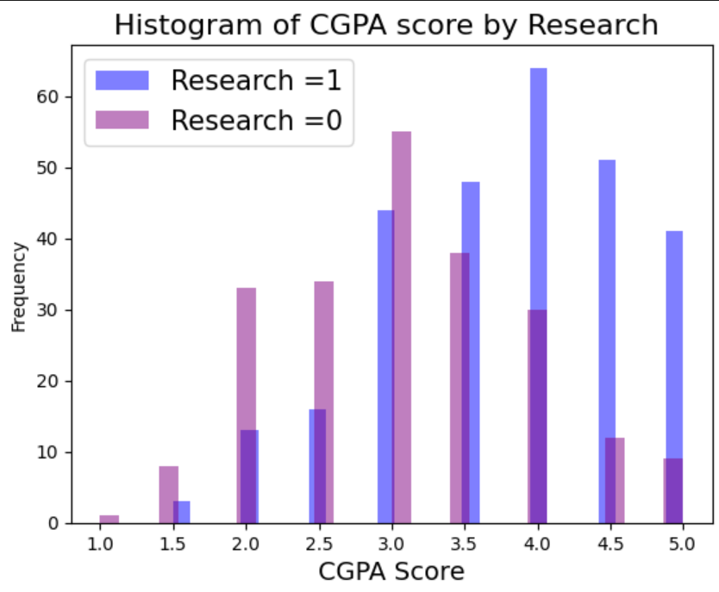
Students with research experience tend to score higher in CGPA than student who don’t.

Slide 7
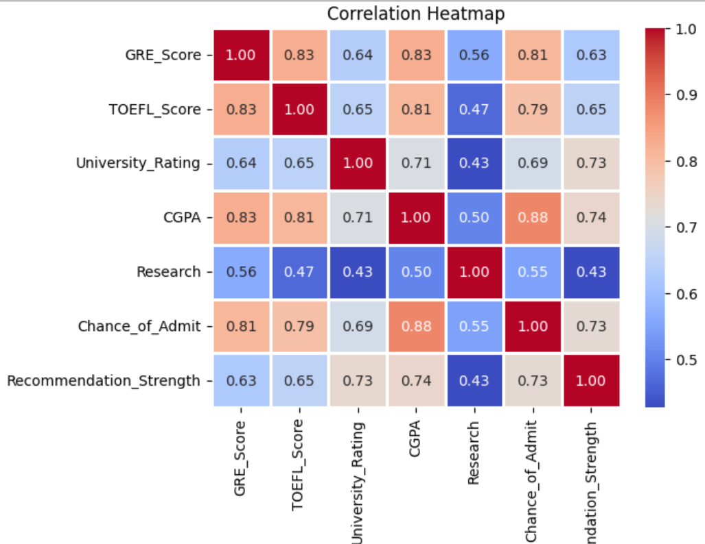
CGPA and GRE score have dominant effect on chance of admit

Slide 8
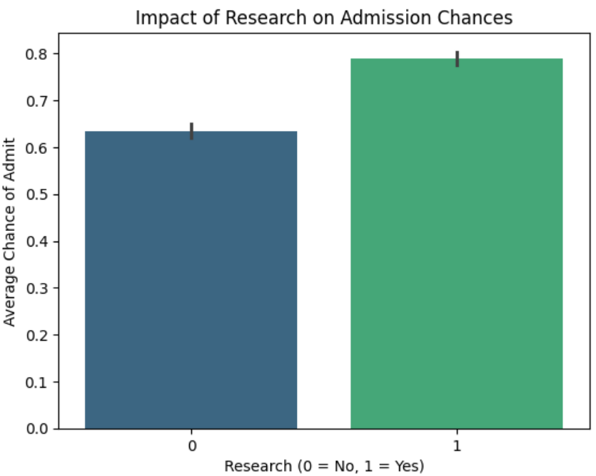
The group of people with and without experience is almost balanced

Slide 9
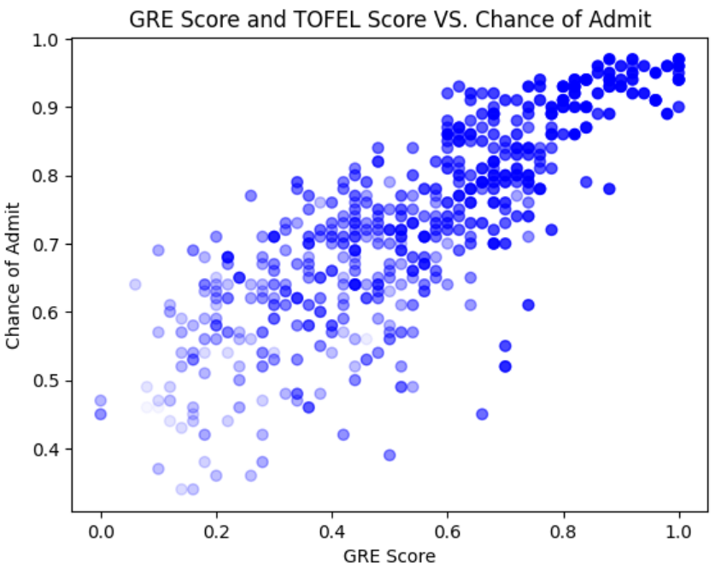
GRE and TOFEL scores seem to have linear and positive relation

Slide 10
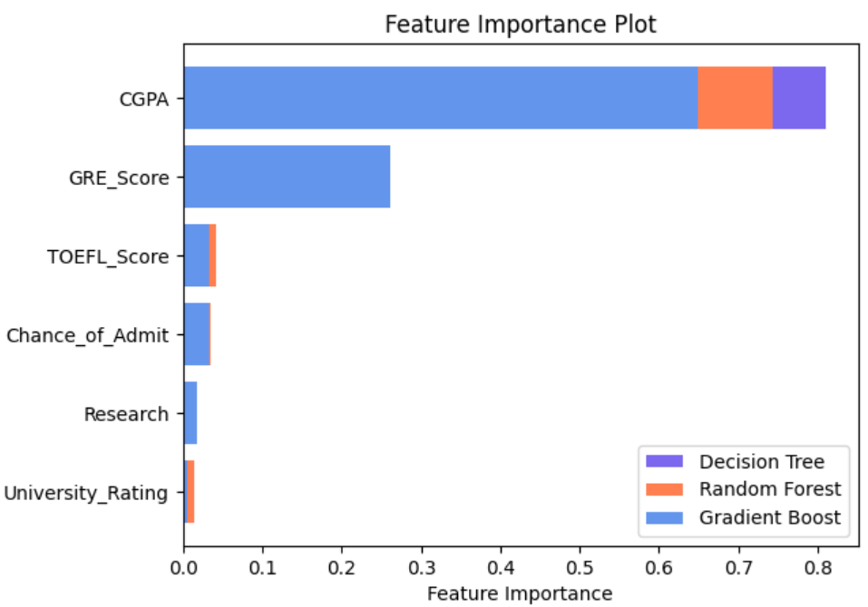
Three models have agreed on CGPA to be the dominant feature, followed by GRE then TOFEL score

Slide 11
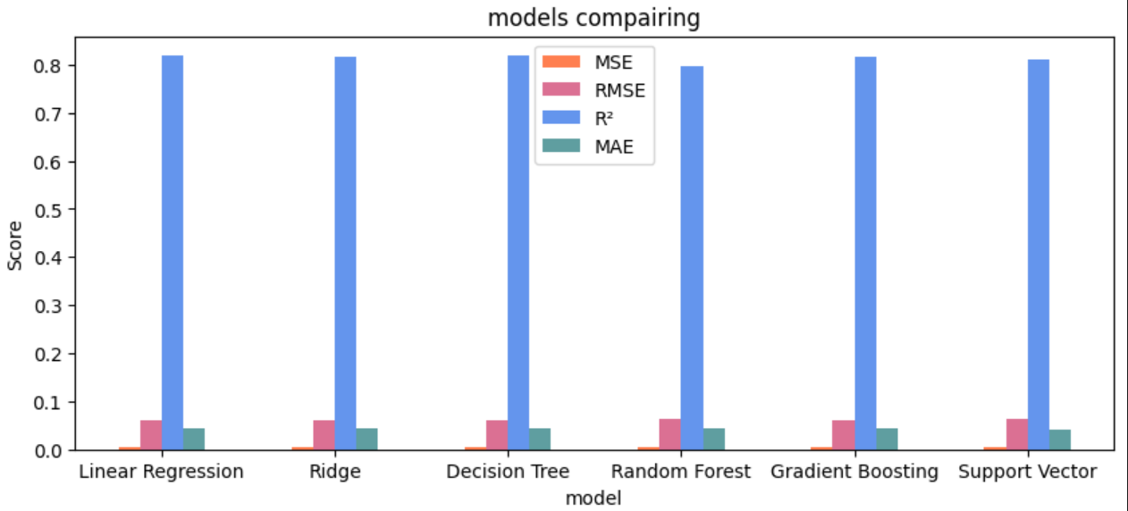
All trained models show an approximate performance

Slide 12
Conclusion

Slide 13
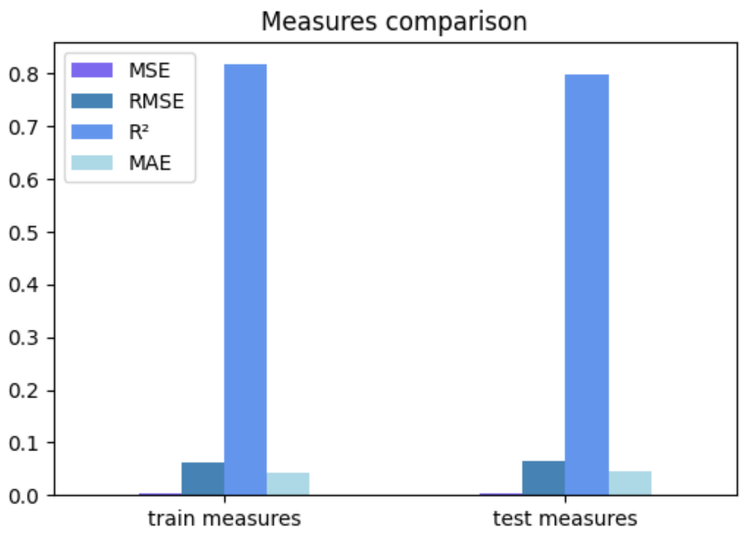
After all, Linear model has been shown best performance among all trained models.

Slide 14


Thank you
represnted by :
Noor Waleed Elemam Sec 7
Nour Amro Elsayed Sec 7
Habiba Amr Ahmed Sec 2
Rahma Taha Elsayed Sec 3
Dalia Rizk Abdelghafar Sec 3

